Slide 1
PLASTIC CONTROL
Presented by:
G .Bindu Sree
D .Gayathri
B .Manisha
G .Sudha Rani

Slide 2
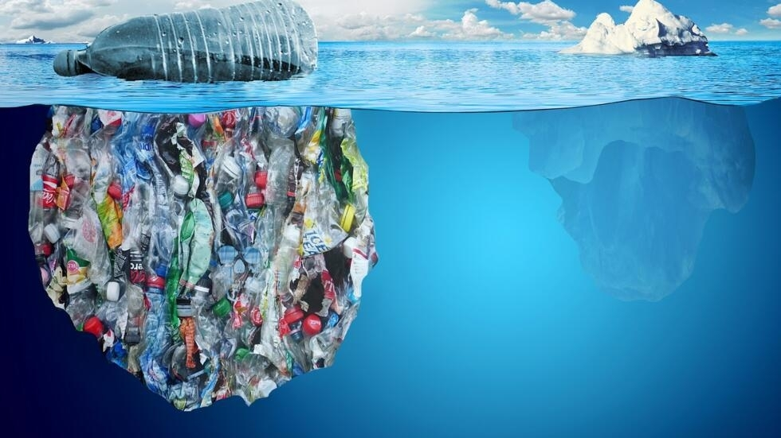
Introduction to Plastic Control
Plastic pollution is a global crisis that requires immediate action. This presentation will explore ways to reduce plastic consumption, improve recycling, and implement innovative alternatives to create a more sustainable future.

Slide 3
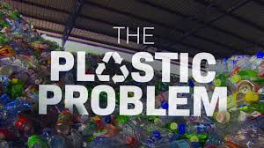
Excessive Waste Billions of tons of plastic are produced and discarded every year, overwhelming landfills and polluting oceans.
Environmental Harm Plastic waste harms wildlife, contaminates eco systems ,and takes centuries to decompose.
Health Concerns Microplastics have been found in our food ,water ,and even our own bodies ,posing potential health risks.
1
2
3

Slide 4
Reducing plastic waste
Recycle
Reuse
Reduce
Say no to single use plastics like straws ,bags and water bottles whenever possible. Option for reusable alternatives like reusable water bottles , grocery bags and storage containers. Make conscious choices to minimize your overall plastic consumption and waste.

Slide 5
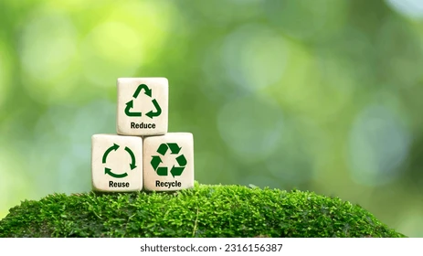
………………………. Identify Learn to identify the different types of plastics and their recycling codes. Separate Sort your plastics by type and prepare them for proper recycling. Recycle utilize local recycling programs and facilities to ensure your plastics processed correctly.
Recycling and Reusing Plastics
1
2
3

Slide 6
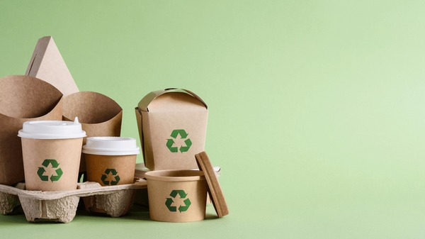
Biodegradable and Compostable Alternatives
Bioplastics Plant-based plastics that can break down naturally over time. | Paper and Cardboard Renewable, recyclable, and biodegradable materials that can replace some plastic packaging.
Compostable Utensils Made from materials like bamboo, corn, or sugarcane that can be composted. | Reusable Containers Durable and long-lasting alternatives to single-use plastic containers.

Slide 7
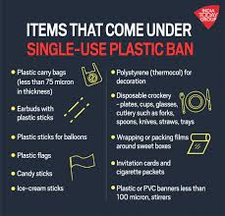




Government Regulations and Initiatives
Plastic Bans Legislation to prohibit the use of certain single-use plastic items. | Recycling Programs Government-funded initiatives to improve recycling infrastructure and access.
Taxes and Fees Policies that incentivize the reduction of plastic use and promote alternatives. | Public Education Campaigns to raise awareness and encourage environmentally-friendly behaviours.

Slide 8

Governmental Policies and Regulations
Plastic Bag Bans Many cities and countries have implemented bans on single-use plastic bags to reduce waste. | Extended Producer Responsibility Policies that hold companies responsible for the entire lifecycle of their products, including disposal.
Recycling Mandates Laws that require certain materials to be recycled, increasing overall recycling rates. | Plastic Taxes Taxes on plastic products to discourage use and incentivize the development of alternatives.

Slide 9
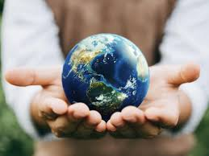
Conclusion and Call to Action
Together ,we can tackle the plastic crisis and create a more sustainable future. By reducing consumption ,improving recycling ,and embracing innovative alternatives ,we can protect our protect our planet and the health of our communities. Join the movement and be a part of the solution .Every action ,no matter how small ,can make a significant difference.

